Slide 1

Module: Marketing Management
Krishanu Rakshit, IIM Calcutta
January 2020

Slide 2
Broad Agenda (which is quite susceptible to change)
Understand what is Marketing?
Develop a “nuanced” understanding of the Basics
“Needs, Wants, Demand, Value, Satisfaction”
What is Segmentation? (Targeting and Positioning)?

Slide 3
Marketing Myopia – by Theodore Levitt
One of the most definitive articles in modern times…

Slide 4
Marketing Myopia
Few observations:
The Railroads are in trouble today not because that need was filled by others….. But because it was not filled up by the railroads themselves.
The history of every dead and dying ‘growth’ industry shows a self-deceiving cycle of bountiful expansion and undetected decay
… then the absence of a problem leads to the absence of thinking.
Mass production does indeed generate great pressure to ‘move’ the product. But what usually gets emphasized, is selling, not Marketing.

Slide 5
Marketing Myopia
Few observations:
The marketing effort is still viewed as a necessary consequence of the product- not vice versa, as it should be.
This is not what the engineer managers say, ……. and this accounts for their concentration on what they know and what they can control-namely product research…
…. Organization must learn to think of itself not as producing goods or services but as buying customers … ..

Slide 6
Re-defining Markets
Suppose you are the seller of Bottled Drinking Water: then what would be your market? Who are your competitors?
(1) Thirst Quenching
(2) Need for Safe Drinking water for a household, an office, etc.

Slide 7
Value
Customers only opt for products, which offer non-negative value!
Value= Sum of Benefits (B₁)- Sum of Costs (C₁)
Price is often a negligible cost
When choosing between alternatives
Choose 1, if V₁>V₂, or, B₁-C₁=B₂-C_{2,} or, ΔB ≥ ΔC
Customers face a range of costs:
Non-monetary: Switching Costs, Psychological Costs, Search costs
Monetary: Installation, Switching (transaction) costs, lifetime costs

Slide 8
Value-sustaining value delivery
Identify what is important and ‘valuable’ to customer
Not what you intend to highlight as a seller
Or, you are strong
Create unmatched value on those attributes/ variables
Vis-à-vis competition
Check Sustainability of such value proposition

Slide 9
Satisfaction
Satisfaction=f(expected service ~ perceived quality/service)
To improve satisfaction, improve quality
Communicate clearly- positioning
Monitoring satisfaction
Tracking satisfaction regularly (feedback system)
Track changes in satisfaction over time- alert for alarms
Measure satisfaction
Variables/ attributes which matter to customer

Slide 10
CLV
Focus on retaining customers
Profitable customers
Important to create a portfolio of customers
Check CLV of each customer group to optimise resources
Cost of acquisition can be very high for some groups
Which would lower profits
Key is in finding out profitable segments

Slide 11
Creating “sticky” customers
Dawar, N. When Marketing is Strategy, Harvard Business Review, December 2013

Slide 12
Marketing Strategy
Evaluating Environment
Reading out Socio-political context
Study of incumbents/ possible entrants
Understanding Customers
Segmentation Analysis
Identification of Key Segments
Implementing Marketing Plan
Positioning the product
Marketing Mix (4P/7P)

Slide 13
Consumer Behaviour
The BLACK BOX!

Slide 14
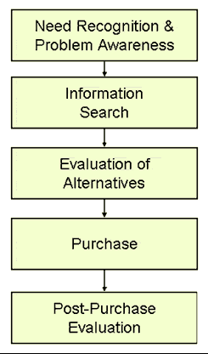
Decision Making Process
The simplest is the:
A-I-D-A model
More ‘detailed’ models

Slide 15
The DM Puzzle
Identification of the Problem (Awareness)
Through Marketing Mix variables
Self Realisation
Need Hierarchy
Triggered by Marketing Mix- (could be situation specific)
A need is a problem that requires a ‘solution’
MMix can provide a ‘solution’
When there was no ‘stated need’

Slide 16
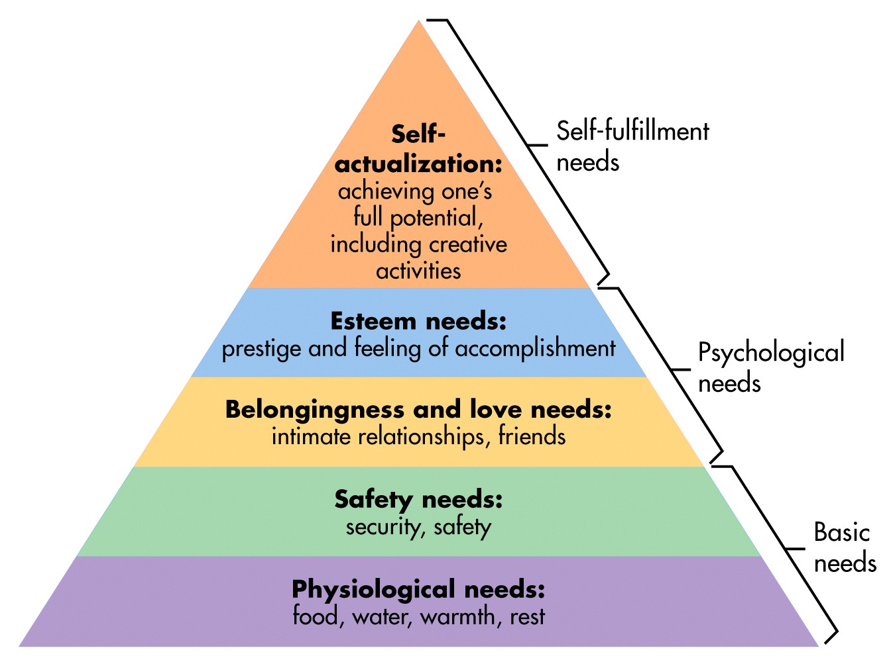
Need, Want and Demand
Needs

Slide 17
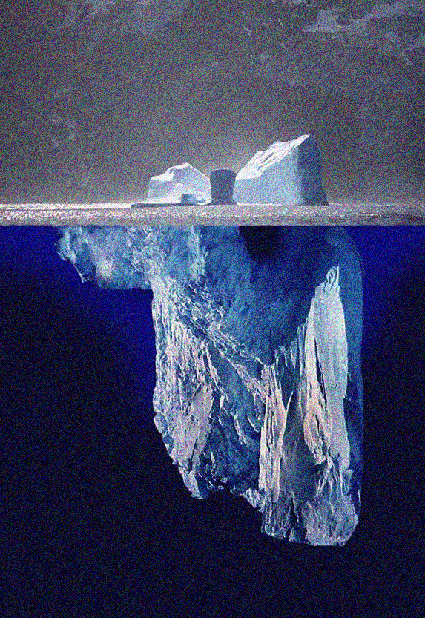
Needs
Felt needs
Latent needs

Slide 18
Needs
Are consumers aware of their needs?
Or, do they need to be made aware?

Slide 19
Need, Want and Demand
Want- a need, which is defined by a possible solution
Hunger is a need (Physiological level)
Pizza could be a want or, better still, a Brand specific “want”
Demand- a want, which is substantiated by a willingness and ability to pay
Associated with a price, which consumers have agreed to pay

Slide 20
The process in flow!
Perception
Attitude
Self Realised
Need Recognition
Evaluation
Decision
Family & Social
MMix
Learning
Personality

Slide 21
Segmentation, targeting & Positioning
Understanding your customers’ needs and planning to reach them!

Slide 22
S-T-P
The process of Segmentation breaks down the population of customers into smaller groups/ clusters
Out of the heterogeneity, need to find homogenous groups
Targeting helps us identify the groups, who are most likely customers
Positioning helps us understand how we can ‘talk’ to these groups of customers (follows the targeting process)

Slide 23
What IS Segmentation?
According to MacDonald and Dunbar, Segmentation is the “process of splitting customers, or potential customers, within a market into different groups, or, segments, within which customers have the same or similar requirements satisfied by a distinct marketing mix”
It is important to ensure that members of a group are as similar as possible, while members are as different as possible between groups!

Slide 24
Possible Segmentation Variables
Geographic:
Urban/rural, north-south, etc.
Demographic:
Age, sex, education, Socio Economic Class (SEC)
Psychographic-
Personality, values and Lifestyle
Behavioural-
Highest and most sophisticated level of segmentation variables
Covers a host of information about the customer groups

Slide 25
Segmentation Variables
Behavioural:
Decision Roles (which role is the consumer playing, when he/she buys the product/ service? E.g. a user, a purchaser, etc.)
Occasions (when? Frequency of purchase, timing, or is it event driven)
Benefits sought from the product/service
User Status / Buyer Readiness Stage
Usage Rate
Loyalty to the brand/product/service
Attitude towards the product/service or brand or, even the consumption situation

Slide 26
Targeting - Factors
Stage of Product-market maturity
Television / Electronic Gadgets market
Extent of Buyer Differentiation
Soap/ Luxury Products category in India (80s and now)
Market Position/ Strength
Adequate Resources (Access to Critical resources)
ITC/ HUL (HLL)
Structure and Intensity of Competition- the 5-Force framework
Production and Marketing Scales- economies of scale and scope

Slide 27
Targeting
Targeting Plan is not static or, sacrosanct for the lifetime
It undergoes change
As opportunities come by
As firm’s relative position changes
As competitive landscape changes etc.
Segment by Segment invasion
A small player slowly can capture larger share in the market by taking up small segments in a phased manner!

Slide 28
Positioning
The great positioning strategist Al Ries puts it this way:
“Positioning is not what you do to the product. Positioning is what you do to the mind of the prospect.”
You may wish to read Trout and Ries’ book “Positioning- the battle for your mind”
Why Positioning?
Today’s market is cluttered with products and brands. In this clutter, consumers are often confused
Brands/ products (& Services) need to differentiate themselves from competition
Positioning helps a brand “anchor” itself in the mind of consumers

Slide 29
Positioning
There are two broad strategies for positioning your brand/product
Point of Parity (PoP)
Point of Difference (PoD)
The strategy that a marketer adopts, depends on:
New Entrant/ Incumbent
Brand Identity
‘Uniqueness’ of the offering

Slide 30
Positioning
Point of Difference (PoD)
Makes the brand Stand out!
Taj Hotels in terms of Luxury
Mercedes Benz in cars- what basis do you compete on?
Kingfisher Airlines – “King of Good times”
Dove- beauty without soap
Godrej PUF
Indigo Airlines (Today)
On-time performance

Slide 31
Positioning
Point of Parity (PoP)
Category Point of Parity
Usually tried by new entrants
New Hotel- high prices, top end location/facilities
New soap brand- fragrance/ material
Competitive Point of Parity
Fiama Di Wills vis-à-vis Dove
Avis vis-à-vis Hertz
We are Number 2, we try Harder!

Slide 32
Positioning Map / Perceptual Maps

Slide 33

Questions & Discussions & Suggestions
Send them krishanu@iimcal.ac.in

